Slide 1

SE101.3

Slide 2
Lecture 07
GUI PROGRAMMING

Slide 3
DONE… ☺
Java Basics
Variables/ Instance variables / Constants
Methods
Classes and Objects
Constructors
Polymorphism
Constructor overloading
Method Overloading
Method Overriding
Encapsulation
Inheritance
Interface
Multiple Inheritance

Slide 4
Today… ☺
GUI Programming….

Slide 5
AWT to Swing
AWT: Abstract Windowing Toolkit
import java.awt.*
Swing: new with Java2
import javax.swing.*
Extends AWT
New improved components
Standard dialog boxes, tooltips, …
Look-and-feel, skins
Event listeners

Slide 6
GUI Component API
Java: GUI component = class
Properties
Methods
Events
JButton

Slide 7
Using a GUI Component
Create it
Instantiate object: b = new JButton(“press me”);
Configure it
Properties: b.text = “Click Me”;
Methods: b.setText(“press me”);
Add it
panel.add(b);
Listen to it
Events: Listeners
JButton

Slide 8
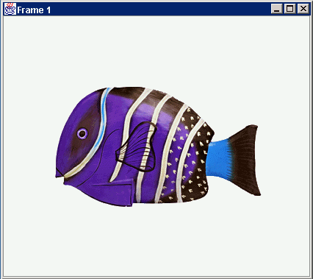
Anatomy of an Application GUI
GUI
Internal structure
JFrame
JFrame
JPanel
containers
JPanel
JButton
JButton
JLabel
JLabel

Slide 9
Build from bottom up
Create:
Frame
Panel
Components
Listeners
Add: (bottom up)
listeners into components
components into panel
panel into frame
Listener
JLabel
JButton
JPanel
JFrame

Slide 10
Code
JFrame f = new JFrame(“title”);
JPanel p = new JPanel( );
JButton b = new JButton(“press me”);
p.add(b); // add button to panel
f.setContentPane(p); // add panel to frame
f.show();
press me

Slide 11
Layout Managers
Automatically control placement of components in a panel
Why?

Slide 12
Layout Manager Heuristics
null
FlowLayout
GridLayout
none, programmer sets x,y,w,h
Left to right,
Top to bottom
BorderLayout
CardLayout
GridBagLayout
n
c
One at a time
w
e
JButton
s

Slide 13
Combinations
JButton
JButton
JTextArea

Slide 14
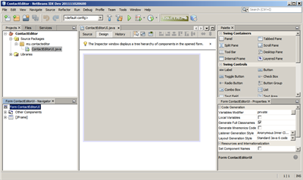
Swing Application Dev using Java
Notes:
Design Area, Palette, PropertyWindow, Navigator

Slide 15
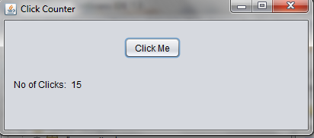

Slide 16
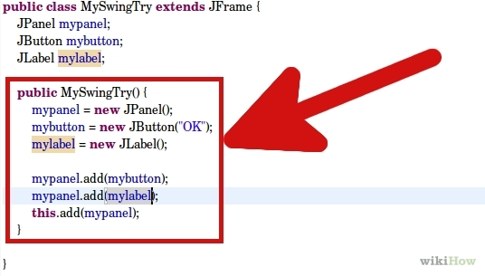
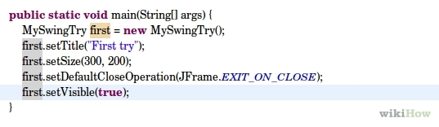

Slide 17
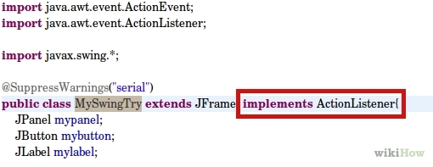
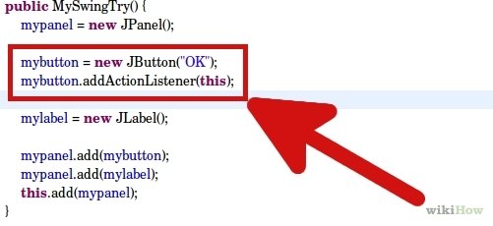

Slide 18
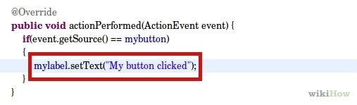

Slide 19
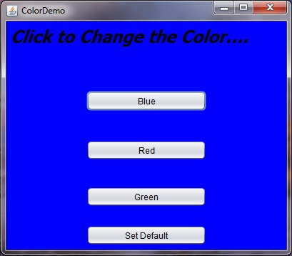
Second Application

Slide 20
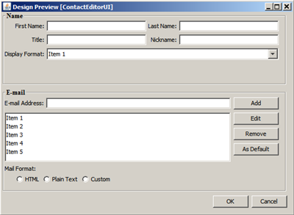
Third Example

Slide 21
THANK YOU
NEXT CLASS:
JDBC

